Slide 1
UNIT-4
BLACKBOX AND WHITEBOX TESTING
Prof. Vivek Dave
Head of Department [MCA & M. Sc. IT]
Faculty of IT & Computer Science
Parul University

Slide 2
Index
Black Box Testing (Functional testing)
  Equivalence Partitioning
  Boundary Value Analysis
  Cause Effect Graphing
White Box Testing (Structural testing)
  Coverage Testing
    Statement Coverage
    Branch And Decision Coverage
    Path Coverage
Comparison of black box and white box testing

Slide 3
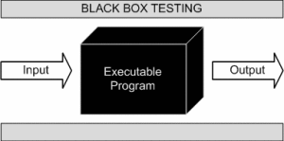
Blackbox Testing
In Black Box Testing we just focus on inputs and output of the software system without bothering about internal knowledge of the software program.
[Figure of Blackbox Testing]
The above Black Box executable program can be any software system you want to test.

Slide 4
Blackbox Testing
By applying black-box techniques, you derive a set of test cases that satisfy the following criteria:
(1) test cases that reduce, by a count that is greater than one the number of additional test cases that must be designed to achieve reasonable testing, and
(2) test cases that tell you something about the presence or absence of classes of errors, rather than an error associated only with the specific test at hand.

Slide 5
Blackbox Testing
Blackbox Techniques/ Methods:
  Equivalence partitioning: It is a software test design technique that involves dividing input values into valid and invalid partitions and selecting representative values from each partition as test data.
  Boundary Value Analysis: It is a software test design technique that involves determination of boundaries for input values and selecting values that are at the boundaries and just inside/ outside of the boundaries as test data.
  Cause effect graphing: It is a software test design technique that involves identifying the cases (input conditions) and effects (output conditions), producing a Cause-Effect Graph, and generating test cases accordingly.

Slide 6
Blackbox Testing
1. Equivalence partitioning:
Equivalence Partitioning also called as equivalence class partitioning.
It can be applied at any level of testing and is often a good technique to use first.
The idea behind this technique is to divide (i.e. to partition) a set of test conditions into groups or sets that can be considered the same (i.e. the system should handle them equivalently), hence ‘equivalence partitioning’.
Equivalence partitioning is a testing technique where input values set into classes for testing.
  Valid Input Class = Keeps all valid inputs.
  Invalid Input Class = Keeps all Invalid inputs.

Slide 7
Blackbox Testing
1. Equivalence partitioning:
Equivalence classes may be defined according to the following guidelines:
1. If an input condition specifies a range, one valid and two invalid equivalence classes are defined.
2. If an input condition requires a specific value, one valid and two invalid equivalence classes are defined.
3. If an input condition specifies a member of a set, one valid and one invalid equivalence class are defined.
4. If an input condition is Boolean, one valid and one invalid class are defined.
By applying the guidelines for the derivation of equivalence classes, test cases for each input domain data item can be developed and executed.

Slide 8
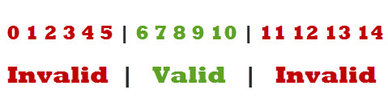
Blackbox Testing
1. Equivalence partitioning:
Example-1:
A text field permits only numeric characters
Length must be 6-10 characters long
Partition according to the requirement should be like this:
Figure- Example of Equivalence partitioning]
While evaluating Equivalence partitioning, values in all partitions are equivalent that’s why 0-5 are equivalent, 6 – 10 are equivalent and 11- 14 are equivalent.

Slide 9
Blackbox Testing
1. Equivalence partitioning:
At the time of testing, test 4 and 12 as invalid values and 7 as valid one.
It is easy to test input ranges 6–10 but harder to test input ranges 2-600. Testing will be easy in the case of lesser test cases but you should be very careful.
Assuming, valid input is 7. That means, you belief that the developer coded the correct valid range (6-10).

Slide 10
Blackbox Testing
2. Boundary Value Analysis:
It’s widely recognized that input values at the extreme ends of input domain cause more errors in system. More application errors occur at the boundaries of input domain.
‘Boundary value analysis’ testing technique is used to identify errors at boundaries rather than finding those exist in center of input domain.
Boundary value analysis is a next part of Equivalence partitioning for designing test cases where test cases are selected at the edges of the equivalence classes.
Boundary value analysis is the process of testing between extreme ends or boundaries between partitions' of the input values.

Slide 11
Blackbox Testing
2. Boundary Value Analysis:
Boundary value analysis is the process of testing between extreme ends or boundaries between partitions' of the input values.
So these extreme ends like Start- End, Lower- Upper, Maximum-Minimum, Just Inside-Just Outside values are called boundary values and the testing is called "boundary value analysis testing".
Example-1:
Suppose you have very important tool at office, accepts valid User Name and Password field to work on that tool, and accepts minimum 8 characters and maximum 12 characters. Valid range 8-12, Invalid range 7 or less than 7 and Invalid range 13 or more than 13.

Slide 12
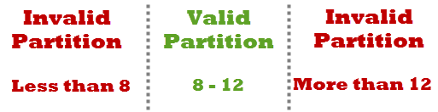
Blackbox Testing
2. Boundary Value Analysis:
[Figure-Example of Boundary Value Analysis]
Write Test Cases for Valid partition value, Invalid partition value and exact boundary value.
  Test Cases 1: Consider password length less than 8.
  Test Cases 2: Consider password of length exactly 8.
  Test Cases 3: Consider password of length between 9 and 11.
  Test Cases 4: Consider password of length exactly 12.
  Test Cases 5: Consider password of length more than 12.

Slide 13
Blackbox Testing
3. Cause effect graphing: A “Cause” stands for a separate input condition that fetches about an internal change in the system. An “Effect” represents an output condition, a system transformation or a state resulting from a combination of causes.
It is a testing technique that aids in choosing test cases that logically relate Causes (inputs) to Effects (outputs) to produce test cases.
According to Myer Cause & Effect Graphing is done through the following steps:
Step – 1: For a module, identify the input conditions (causes) and actions (effect).
Step – 2: Develop a cause-effect graph.
Step – 3: Transform cause-effect graph into a decision table.
Step – 4: Convert decision table rules to test cases. Each column of the decision table represents a test case.

Slide 14
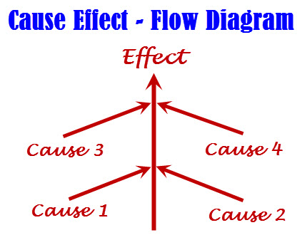
Blackbox Testing
[Figure of Cause Effect-Flow Diagram]

Slide 15
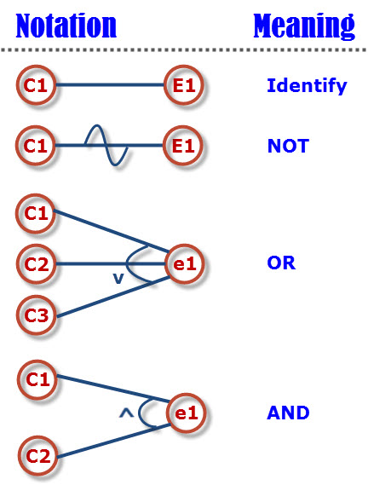
Blackbox Testing
[Symbols used in Cause Effect-Flow Diagram]

Slide 16
Blackbox Testing
Example:
The “Print message” is software that read two characters and, depending of their values, messages must be printed.
The first character must be an “A” or a “B”.
The second character must be a digit.
If the first character is an “A” or “B” and the second character is a digit, the file must be updated.
If the first character is incorrect (not an “A” or “B”), the message X must be printed.
If the second character is incorrect (not a digit), the message Y must be printed.

Slide 17
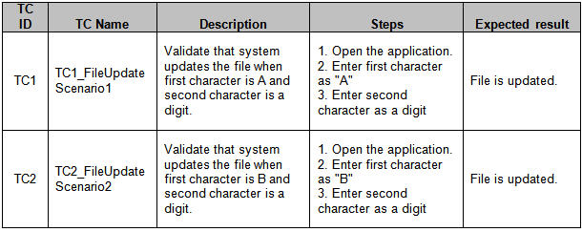
Blackbox Testing
[Test cases for previous example]

Slide 18
:Whitebox Testing:
White Box Testing (also known as Clear Box Testing, Open Box Testing, Glass Box Testing, Transparent Box Testing, Code-Based Testing or Structural Testing) is a software testing method in which the internal structure/ design/ implementation of the item being tested is known to the tester.
White Box Testing is like the work of a mechanic who examines the engine to see why the car is not moving.
Using white-box testing methods, you can derive test cases that
(1) guarantee that all independent paths within a module have been exercised at least once
(2) exercise all logical decisions on their true and false sides
(3) execute all loops at their boundaries and within their operational bounds
(4) exercise internal data structures to ensure their validity.

Slide 19
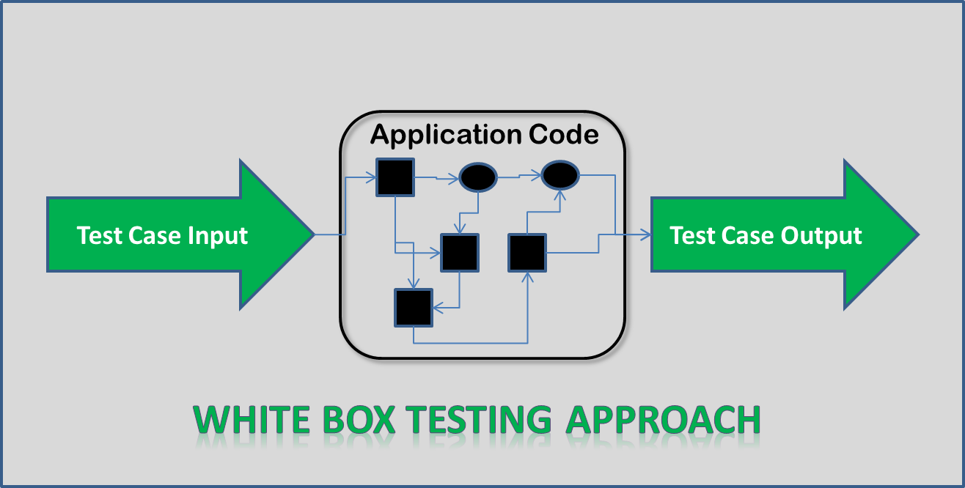
:Whitebox Testing:
[Figure of Whitebox Testing Approach]

Slide 20
:Whitebox Testing:
Why and When White-Box Testing:
White box testing is mainly used for detecting logical errors in the program code.
It is used for debugging a code, finding random typographical errors, and uncovering incorrect programming assumptions.
White box testing is done at low level design and implementable code.
It can be applied at all levels of system development especially Unit, system and integration testing.
White box testing can be used for other development artifacts like requirements analysis, designing and test cases.

Slide 21
:Whitebox Testing:
Whitebox Testing Techniques:
Following are Whitebox testing techniques:
  Statement coverage: This technique is aimed at exercising all programming statements with minimal tests.
  Branch and decision coverage: This technique is running a series of tests to ensure that all branches are tested at least once.
    Tools: An example of a tool that handles branch coverage testing for C, C++ and Java applications is TCAT-PATH
  Path coverage: This technique corresponds to testing all possible paths which means that each statement and branch is covered.

Slide 22
:Whitebox Testing:
1. Statement coverage:
Statement coverage is a white box testing technique, which involves the execution of all the statements at least once in the source code.
Through statement coverage we can identify the statements executed and where the code is not executed because of blockage.
The statement coverage covers only the true conditions. The main drawback of this technique is that we cannot test the false condition in it.
The statement coverage is count as per below formula:
(Statement coverage = No of statements Executed/Total no of statements in the source code * 100)

Slide 23
:Whitebox Testing:
Example:
Read A
Read B
if A>B
Print “A is greater than B”
else
Print "B is greater than A"
endif
Set1 :If A =5, B =2
No of statements Executed: 5
Total no of statements in the source code: 7
Statement coverage =5/7*100 = 71.00 %
Set1 :If A =2, B =5 [False-Not supported by Statement coverage]
No of statements Executed: 6
Total no of statements in the source code: 7
Statement coverage =6/7*100 = 85.20 %

Slide 24
:Whitebox Testing:
2. Branch/Decision coverage:
Branch coverage is also known as Decision coverage or all-edges coverage.
It covers both the true and false conditions unlikely the statement coverage.
A branch is the outcome of a decision, so branch coverage simply measures which decision outcomes have been tested.
This sounds great because it takes a more in-depth view of the source code than simple statement coverage
The formula to calculate decision coverage is:
Decision Coverage=(Number of decision outcomes executed/Total number of decision outcomes)*100%

Slide 25
:Whitebox Testing:
Example:
READ X
READ Y
IF (X > Y)
PRINT “X is greater that Y”
ENDIF
To get 100% statement coverage only one test case is sufficient for this pseudo-code.
TEST CASE 1: X=10 Y=5
However this test case won’t give you 100% decision coverage as the FALSE condition of the IF statement is not exercised.
In order to achieve 100% decision coverage we need to exercise the FALSE condition of the IF statement which will be covered when X is less than Y.

Slide 26
:Whitebox Testing:
So the final TEST SET for 100% decision coverage will be:
TEST CASE 1: X=10, Y=5
TEST CASE 2: X=2, Y=10
Note: 100% decision coverage guarantees 100% statement coverage but 100% statement coverage does not guarantee 100% decision coverage.
3. Path coverage:
The basis path method enables the test-case designer to derive a logical
complexity measure of a procedural design and use this measure as a guide for defin-ing a basis set of execution paths. Test cases derived to exercise the basis set are guar-anteed to execute every statement in the program at least one time during testing.

Slide 27
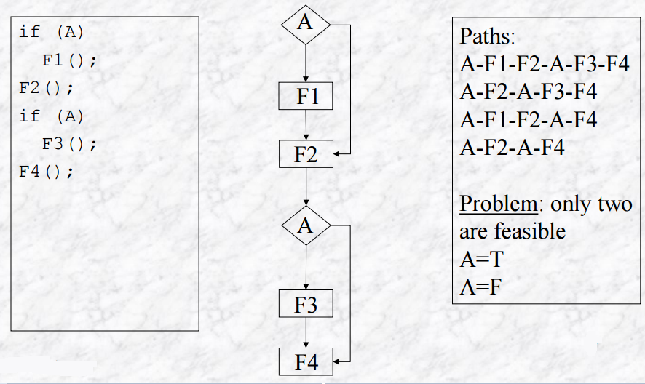
:Whitebox Testing:
[Figure of Path coverage Example]

Slide 28
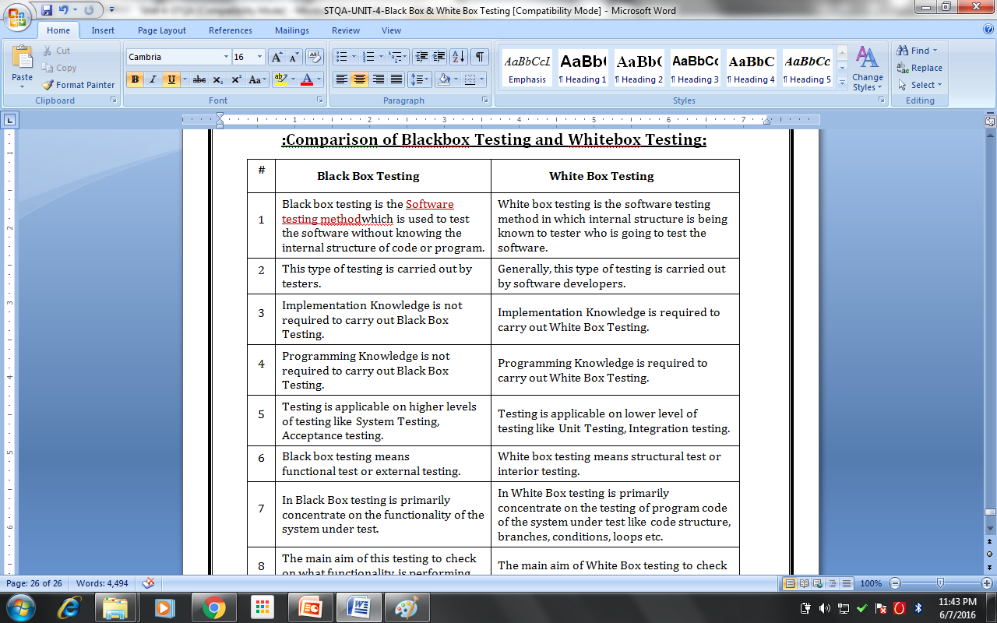
:Comparison of Blackbox Testing and Whitebox Testing:

Slide 29
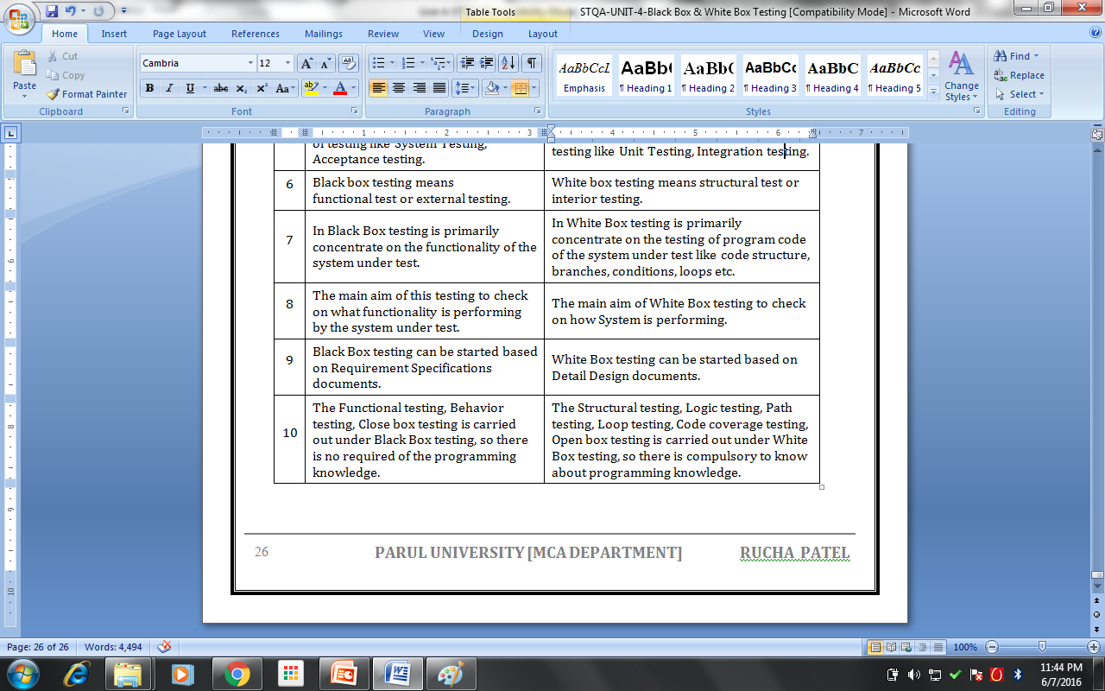
:Comparison of Blackbox Testing and Whitebox Testing:

Slide 30
Thank You

